Slide 1

Research Communication Skills
Introduction to the subject

Slide 2
Intended Learning Outcomes
By the end of this lesson, you will be able to:
  Describe a research process, key players and goals
  Understand the background of academic writing & language

Slide 3

Introduction to research

Slide 4
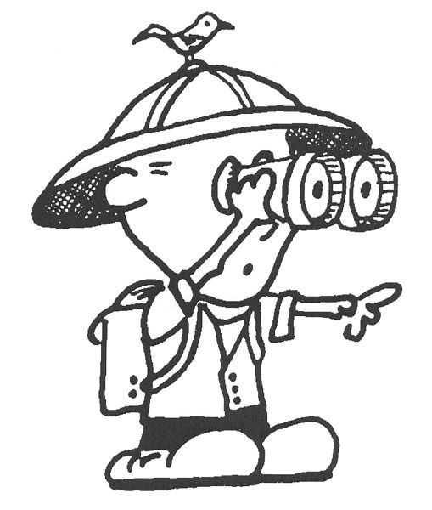
Research (1)
The process of exploring the unknown, studying and learning new things, building new knowledge about things that no one has understood before

Slide 5

Research (2)
The activity of a diligent and systematic inquiry or investigation in an area, with the objective of discovering or revising facts, theories, applications etc.

Slide 6

Research (3)
An investigative process of finding reliable solution to a problem through a systematic selection, collection, analysis and interpretation of data

Slide 7

Research (4)
All activities that make us discover new knowledge about things around us

Slide 8
Research (3)
An investigative process of finding reliable solution to a problem through a systematic selection, collection, analysis and interpretation of data

Slide 9
Research Process
Realize there is a problem
Look to see if anyone has solved it
Develop a plan to solve it
Solve it
Evaluate your solution
Disseminate your solution

Slide 10
Research Process
Realize there is a problem
Look to see if anyone has solved it
Develop a plan to solve it
Solve it
Evaluate your solution
Disseminate your solution

Slide 11
Realize there is a problem
Research begins with a problem
Identifying this problem can actually be the hardest part of research
In general, good research projects should:
  Address an important question
    original and significant
  Advance knowledge

Slide 12
Sources of Research Problems
Observation
Experts
Previous experience
Literature reviews
Professional conferences

Slide 13
Research Process
Realize there is a problem
Look to see if anyone has solved it
Develop a plan to solve it
Solve it
Evaluate your solution
Disseminate your solution

Slide 14
Look to see if anyone has solved it
The available literature is reviewed to determine if there is already a solution to the problem.
When performing the review:
  Start searching professional journals
  Begin with the most recent articles you can find
  Keep track of relevant articles in a bibliography
  Don’t be discouraged if work on the topic is already underway
If the literature review turns up nothing, then additional research activities are justified
Notes:
The literature review is often a good source for additional ideas. This is also a good place to go in conjunction with the prior step; there’s no point in wasting good brain cells coming up with hypotheses that solve a problem that has already been adequately addressed.

Slide 15
Research Process
Realize there is a problem
Look to see if anyone has solved it
Develop a plan to solve it
Solve it
Evaluate your solution
Disseminate your solution

Slide 16
Develop a plan to solve it
Research proposals are documents that describe the intended research including:
  Problem and subproblems
  Hypotheses
  Definitions
  Assumptions
  Importance
  Literature review
  …
Notes:
There are some basic variations on this theme, but all of these areas will be covered. This format serves to crystalize your thought process and to help ensure that no critical elements of your research have been neglected.

Slide 17
Research Process
Realize there is a problem
Look to see if anyone has solved it
Develop a plan to solve it
Solve it
Evaluate your solution
Disseminate your solution

Slide 18
Solve it
  Remember that the solution is supposed to be better compared to the best solution from the literature

Slide 19
Research Process
Realize there is a problem
Look to see if anyone has solved it
Develop a plan to solve it
Solve it
Evaluate your solution
Disseminate your solution

Slide 20
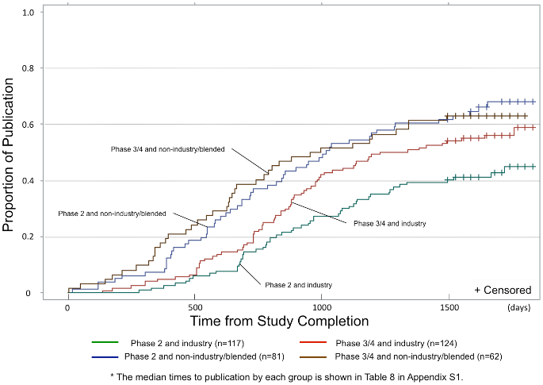
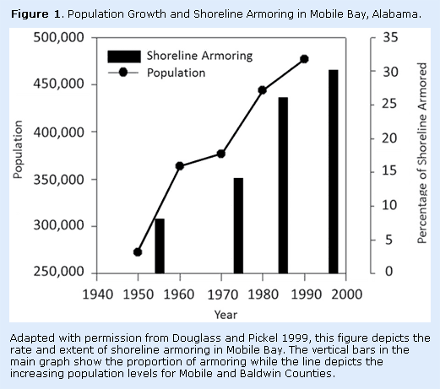
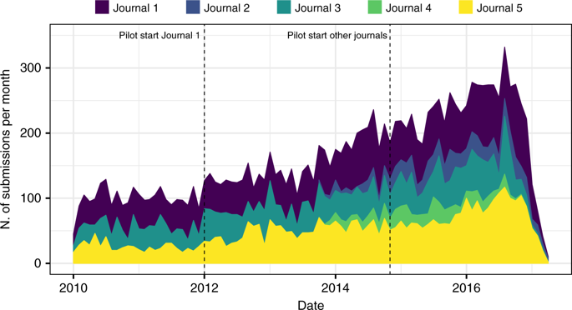
Evaluate your solution
How is your solution better?
Measure it
  Latency, throughout, fault tolerance
  space
  usability, manageability
  …

Slide 21
Evaluate your solution
Mathematical analysis
Simulation analysis to show performance
Implementation analysis to show complexity

Slide 22
Research Process
Realize there is a problem
Look to see if anyone has solved it
Develop a plan to solve it
Solve it
Evaluate your solution
Disseminate your solution

Slide 23
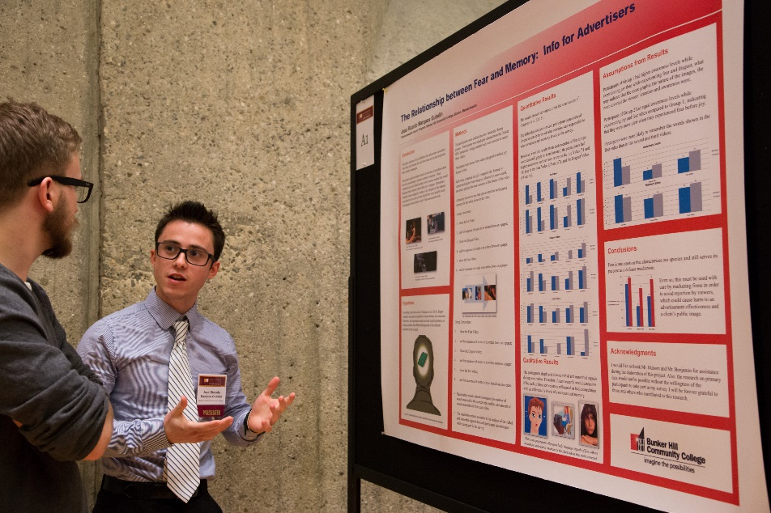

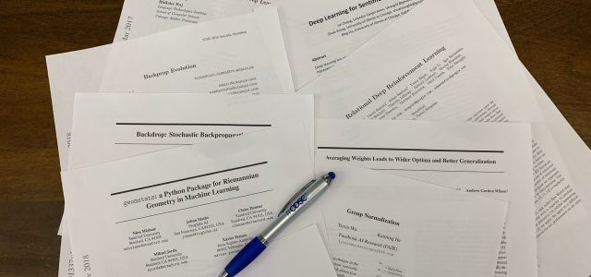
Disseminate your solution
Written communication
  Papers - Conference, Journal
Verbal communication
  Research posters
  Oral presentations

Slide 24


Slide 25

Language of science
Scientific languages are common languages used by one or several scientific communities for international communication.

Slide 26
Language of science - until the 19th century
Classical languages
  Europe – Latin
  Indian and South Asian region - Sanskrit
  East Asia - Classical Chinese

Slide 27
Language of science - 1800–1920
The emergence of scientific journals was both a symptom and cause of the declining use of a classical language.
  The first two modern scientific journals were published simultaneously in 1665, they both used the local vernacular
    The Journal des Sçavans in France – French language
    The Philosophical Transactions of the Royal Society in England – English language
Three dominant languages of science (each language would be expected to be understood for the purpose of international scientific communication)
  French
  English
  German

Slide 28
Language of science - (1920–1965)
A transition period
  English had become the leading language of science
  However, a large share of global research continued to be published in other languages, and language diversity even seemed to increase until the 1960s

Slide 29
Language of science - (1965 onwards)
English as a global standard
  Nearly all the scientific publications indexed on the leading commercial academic search engines are in English.
    95.86% of the 28,142,849 references indexed on the Web of Science (2022)
    84.35% of the 20,600,733 references indexed on Scopus (2022)
  Academics in non-English speaking countries get promoted based on their publications in English language journals
    Non-English publications can be held less valuable since they are not indexed in international rankings

Slide 30
Language of science in China
In local journals, scientific publications are published in Chinese
To boost the dissemination of Chinese research results, the central government and higher education institutions had introduced various schemes to encourage international publications
  Research evaluation systems result in most of the research to be published in English and abide to the linguistic norms set up by commercial indexes

Slide 31
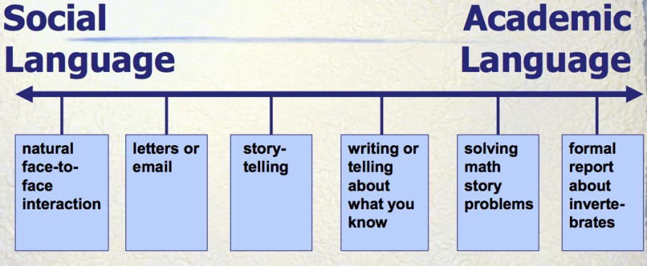

Slide 32
Exercise
The two texts in front of you talk about the impact of cloud computing on businesses.
Compare their tone, style, and structure

Slide 33
The same topic can be adapted to different contexts, with each format requiring a distinct approach

Slide 34
Audience and Purpose
Text 1: News Article
  Aimed at a general audience
  The purpose is to inform and provide an overview of the trend. The focus is on factual reporting with minimal analysis.
Text 2: Blog Post
  Written for a broad audience, possibly business owners or non-technical readers.
  The purpose is to persuade and engage, using a conversational tone and focusing on the practical benefits of cloud computing.

Slide 35
Style and Tone
Text 1: News Article
  Neutral and straightforward, focusing on clarity and conciseness.
  The tone is informative without being overly technical.
Text 2: Blog Post
  Informal, engaging, and persuasive.
  The tone is conversational, with a focus on connecting with the reader and making the content relatable.

Slide 36
Structure
Text 1: News Article
  Inverted pyramid structure, where the most important information comes first.
  This allows readers to get the gist of the article even if they don’t read the whole thing.
Text 2: Blog Post
  Flexible and often nonlinear, focusing on readability and engagement.
  It may include headings, bullet points, and direct appeals to the reader.

Slide 38
Academic English
Academic English is the style of language used in the fields of education, science, technology, and global connections.

Slide 39
Academic English Example
Research paper
  Audience and Purpose
    Targeted at academics, professionals, and students, the purpose is to contribute to scholarly discussion with in-depth analysis and evidence. The writing is formal, objective, and detailed.
  Style and Tone
    Formal and analytical, with a focus on precise language and a structured argument. The tone is objective and academic.
  Structure
    Structured with a clear academic framework, including sections like Abstract, Introduction, Methodology, and Discussion. The argument is built progressively.

Slide 40
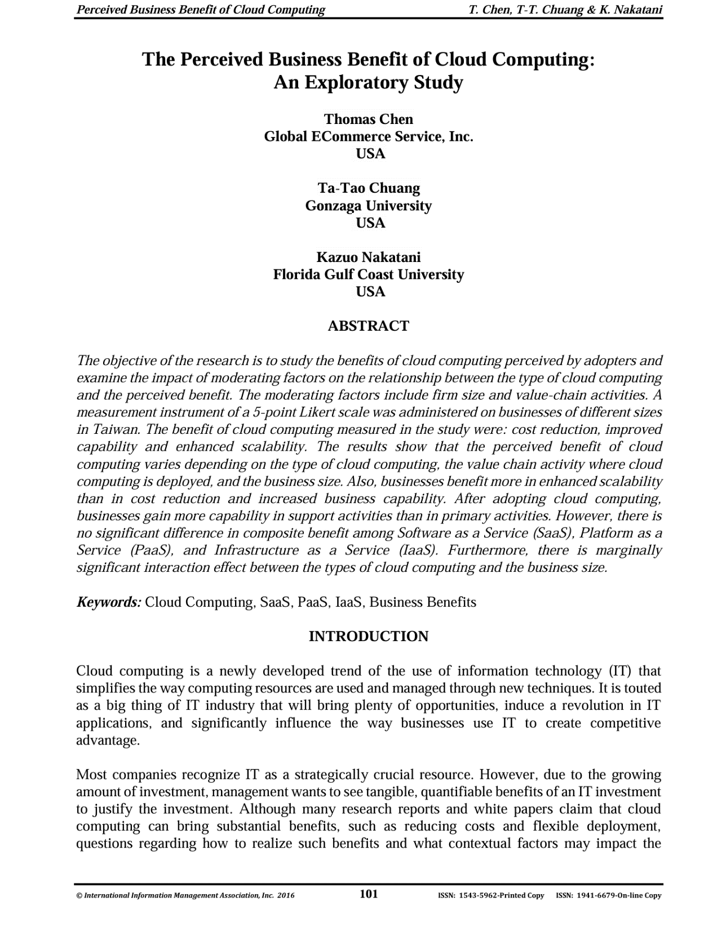
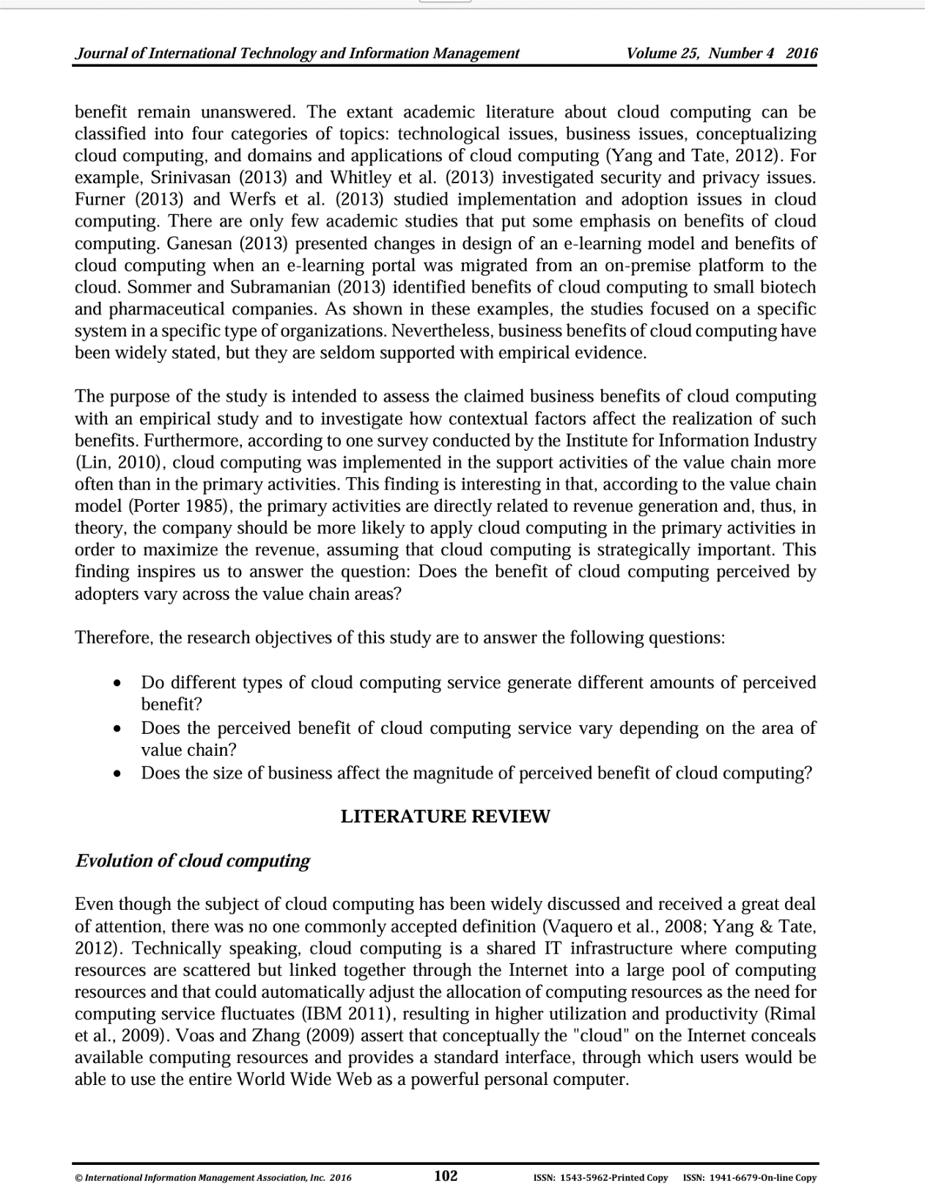

Slide 43
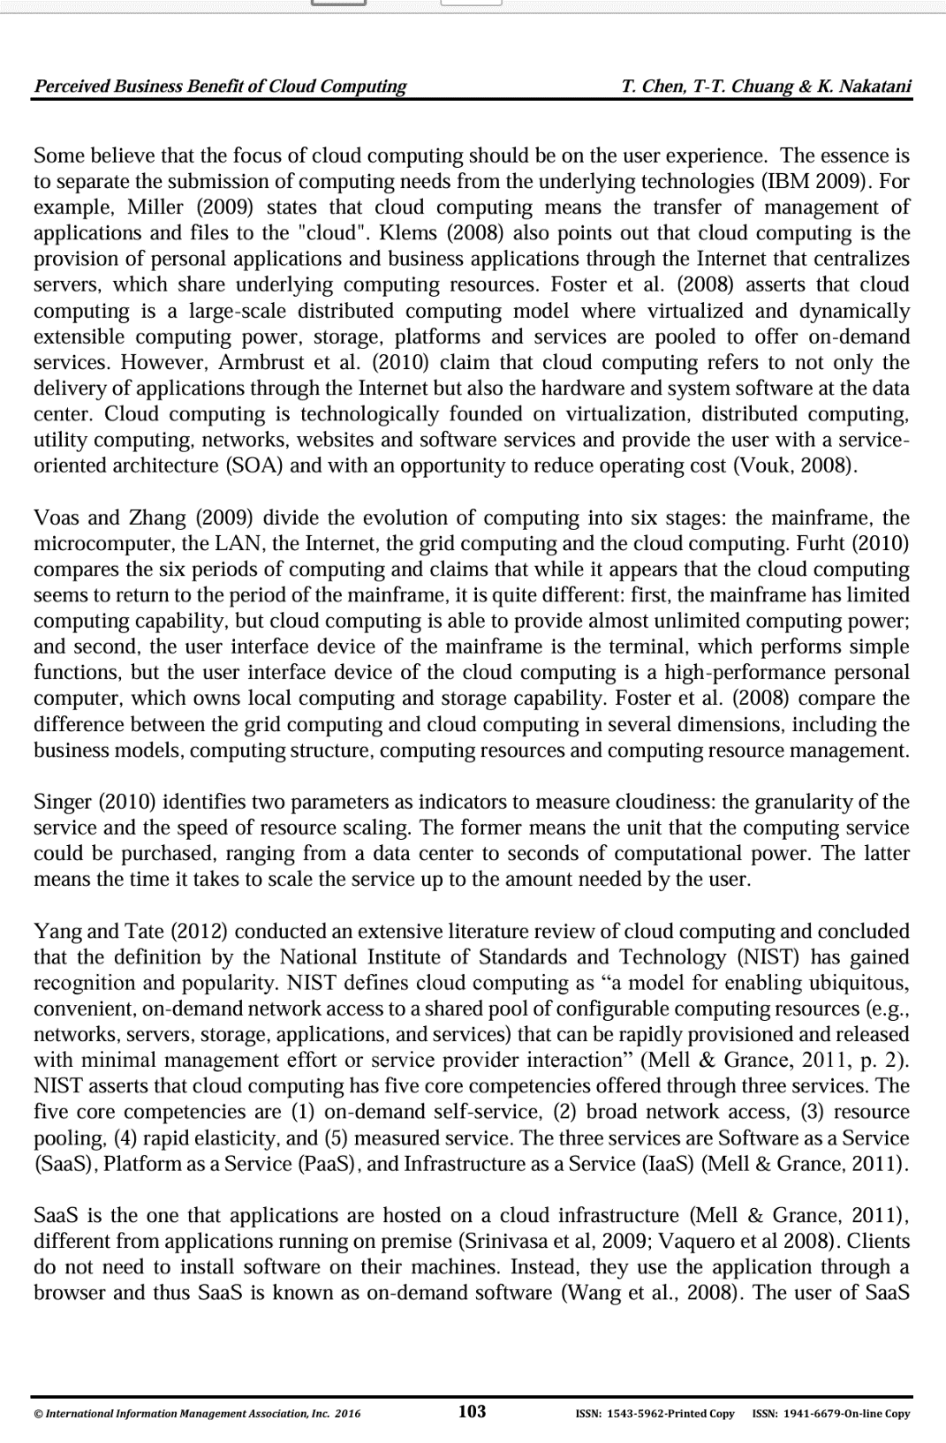
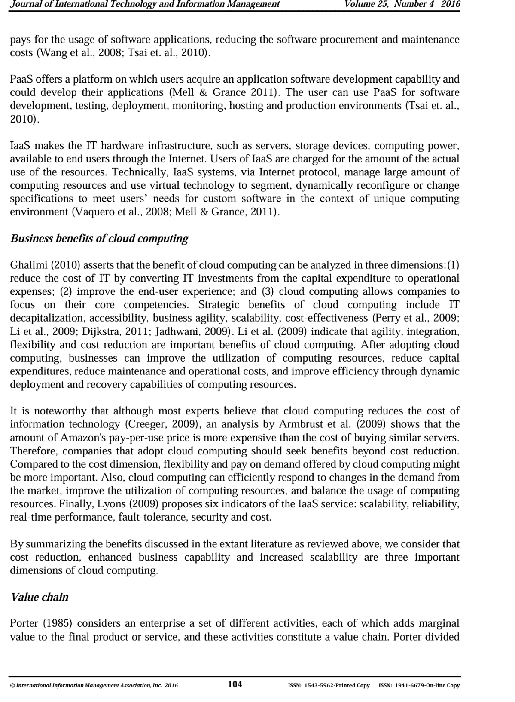

Slide 44
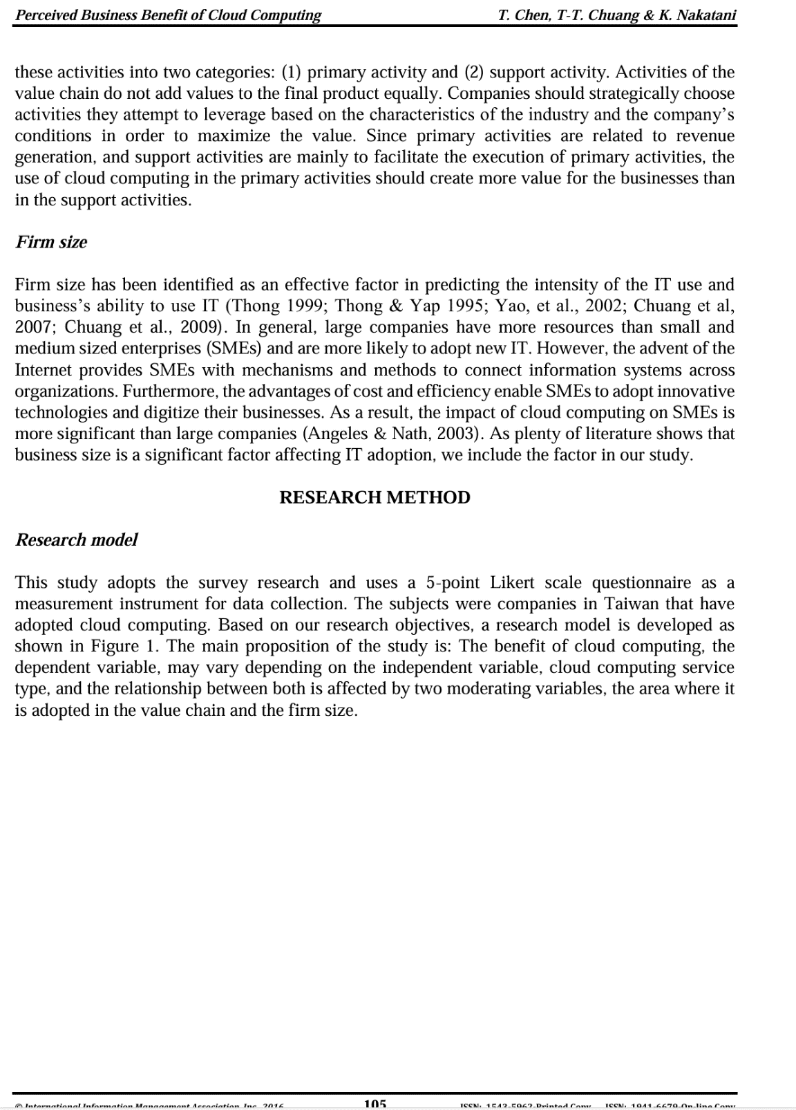
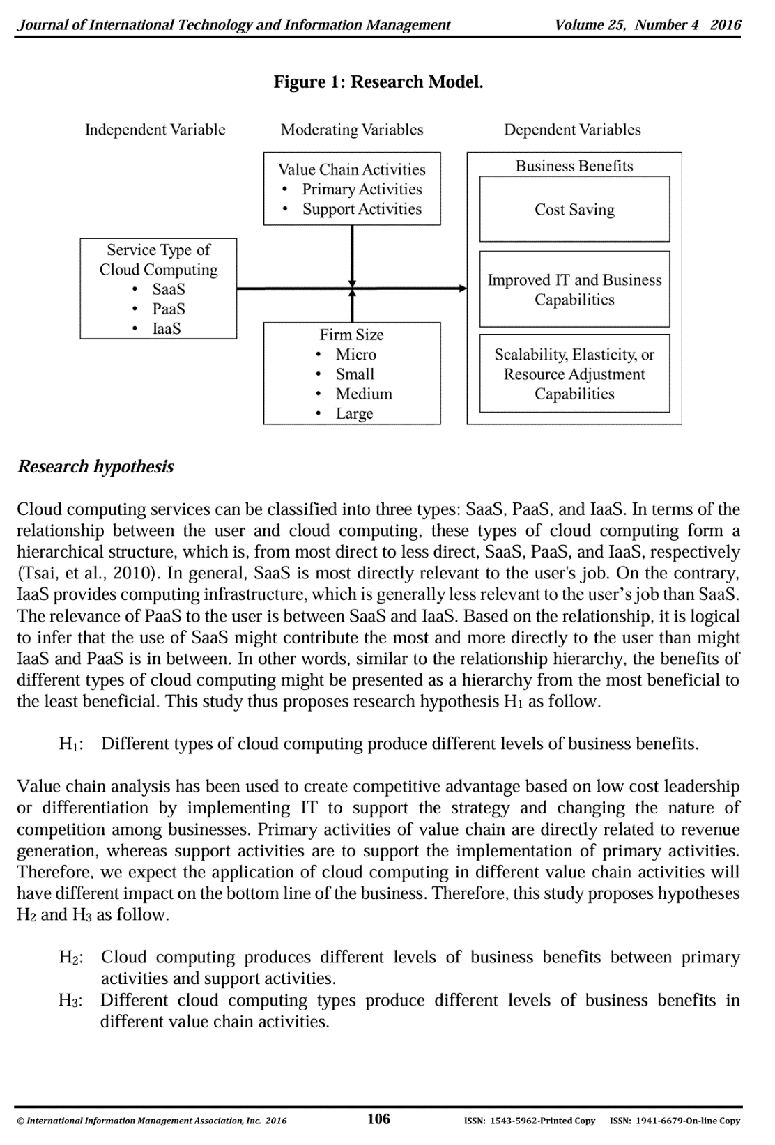

Slide 45
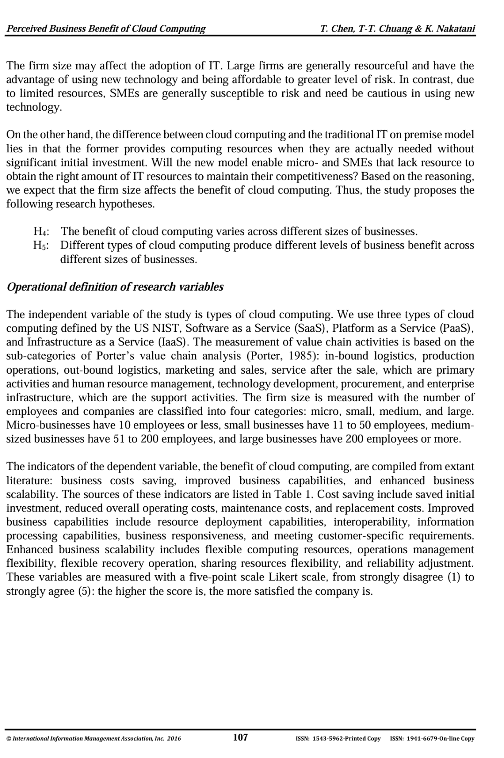
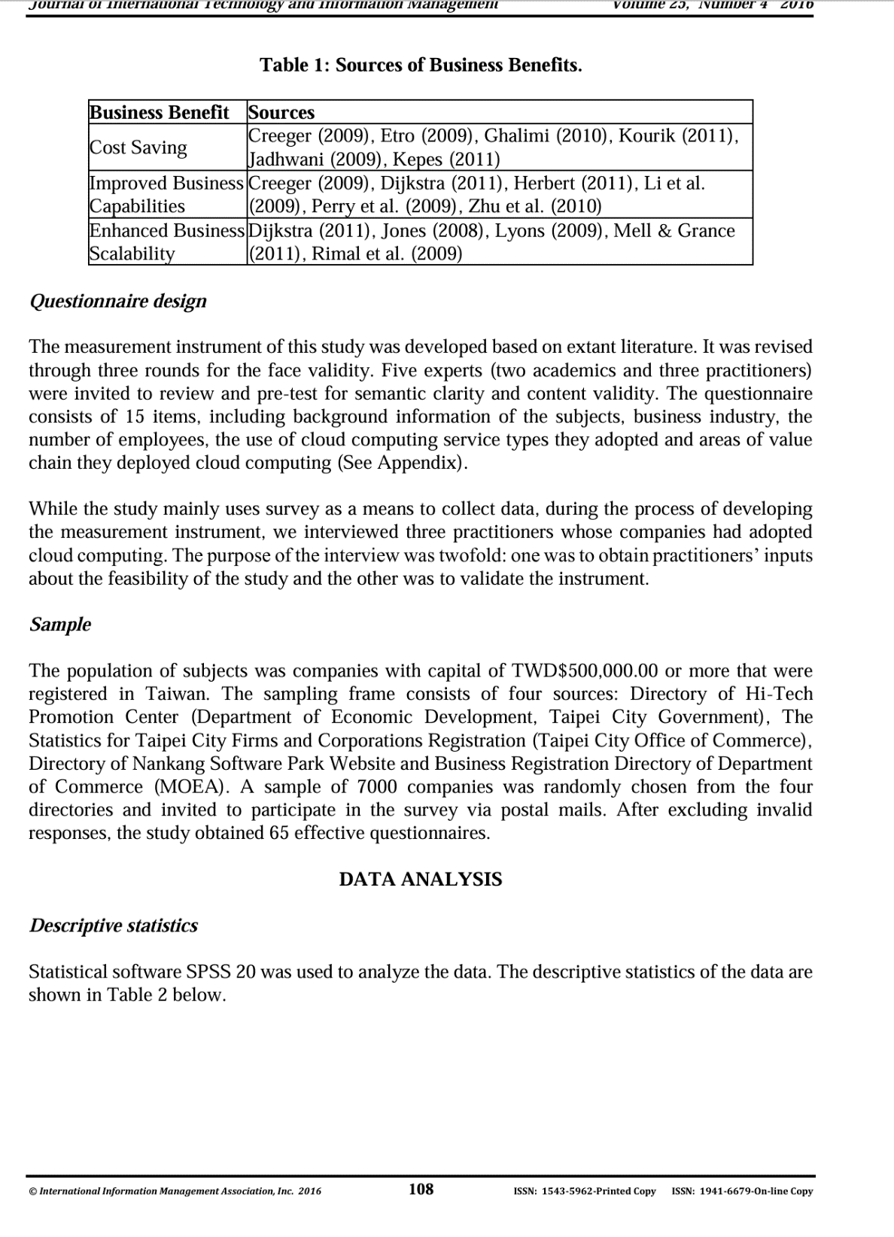

Slide 46
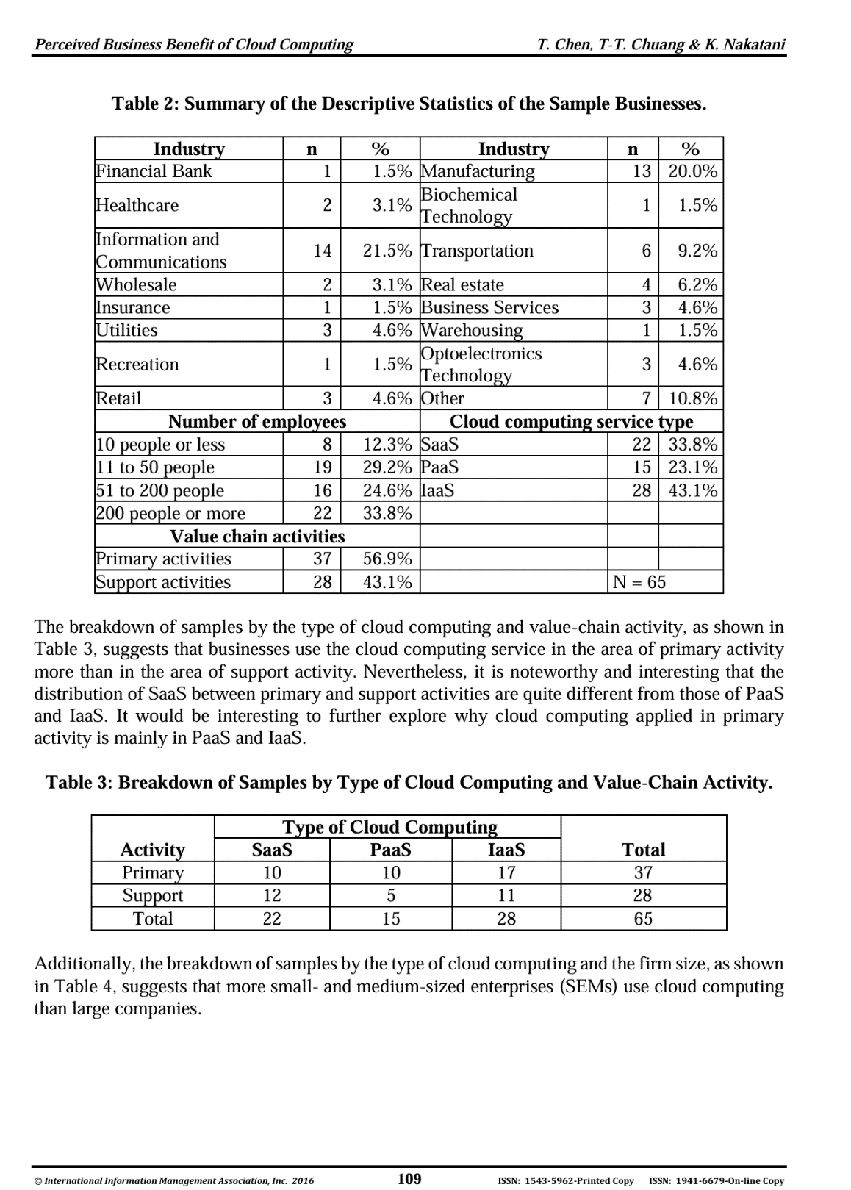
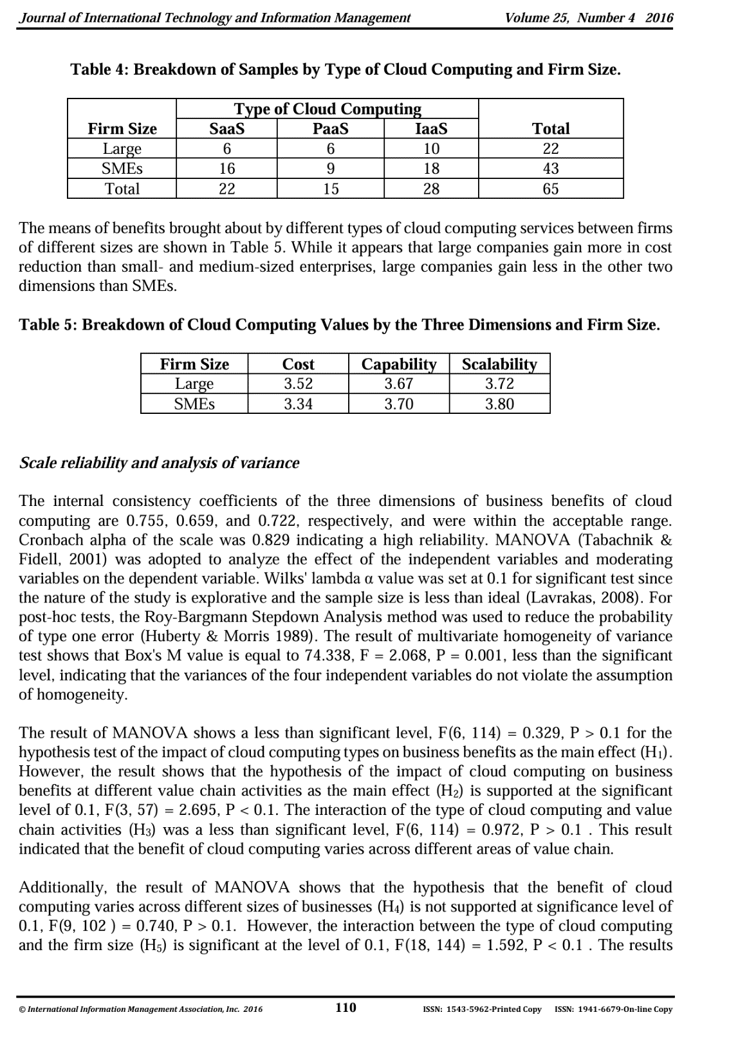

Slide 47
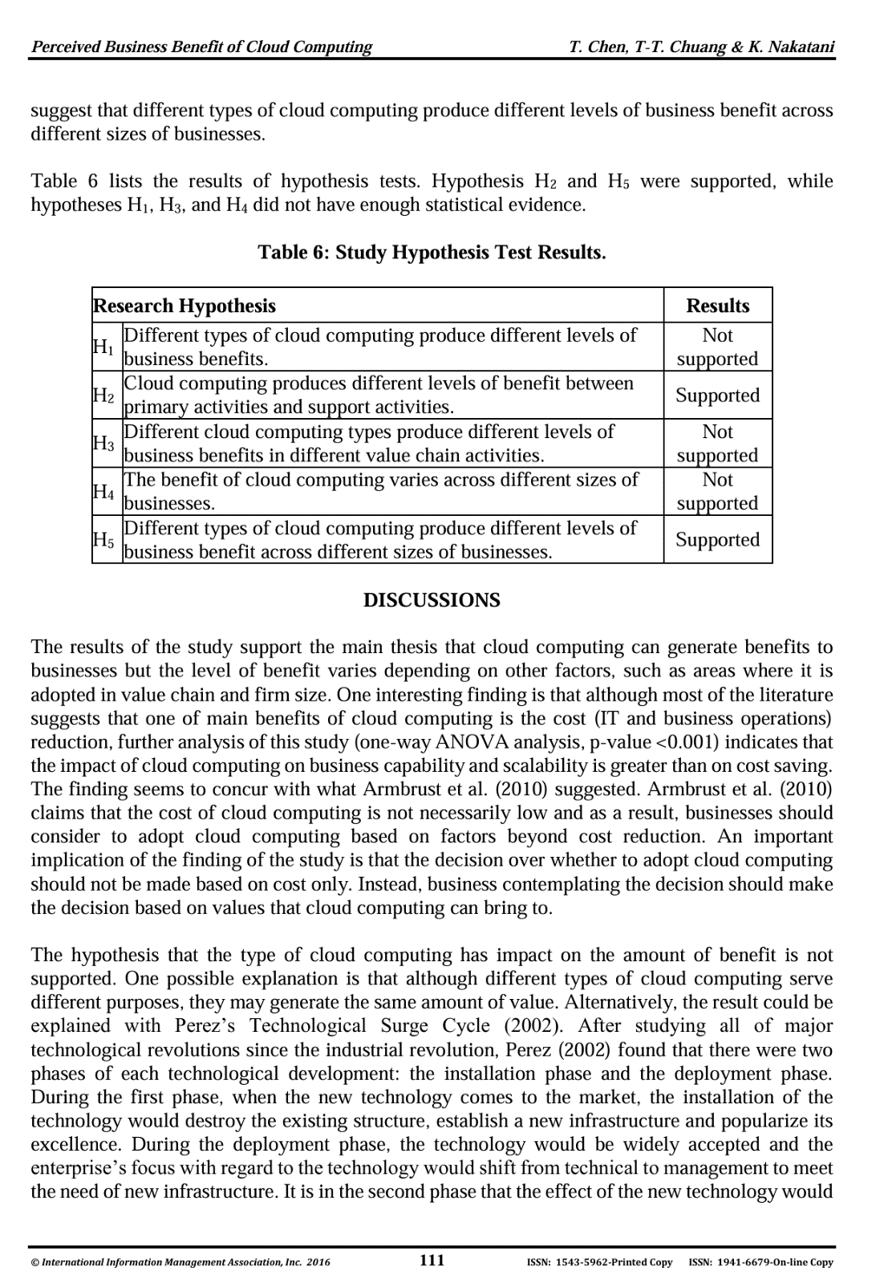
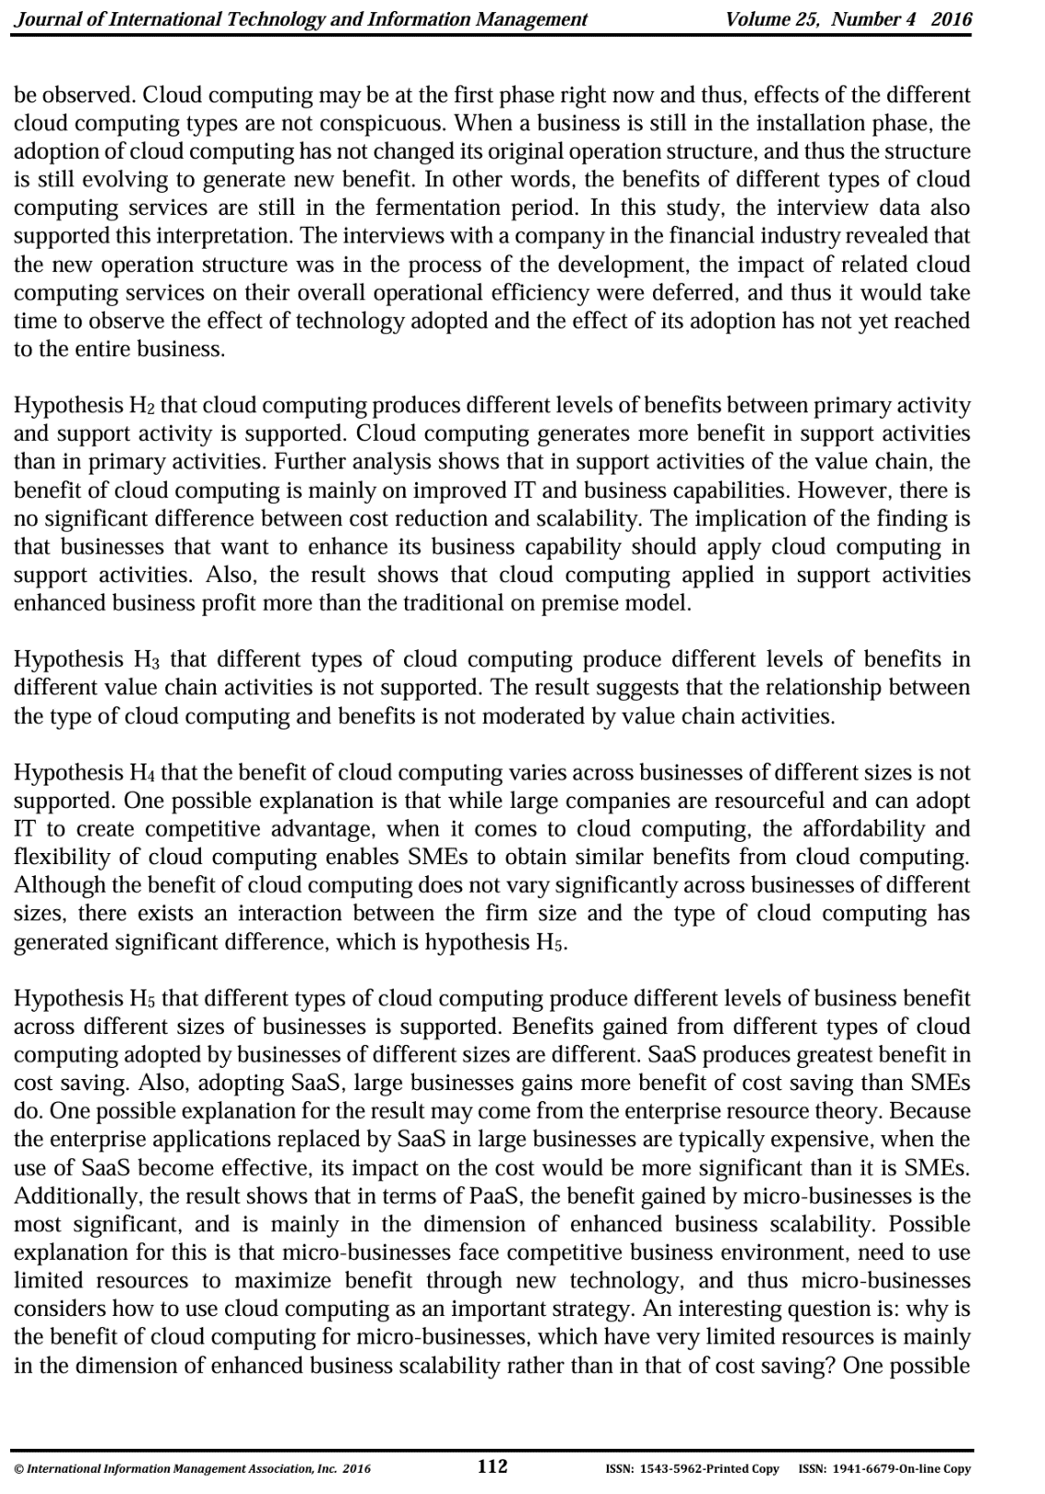

Slide 48
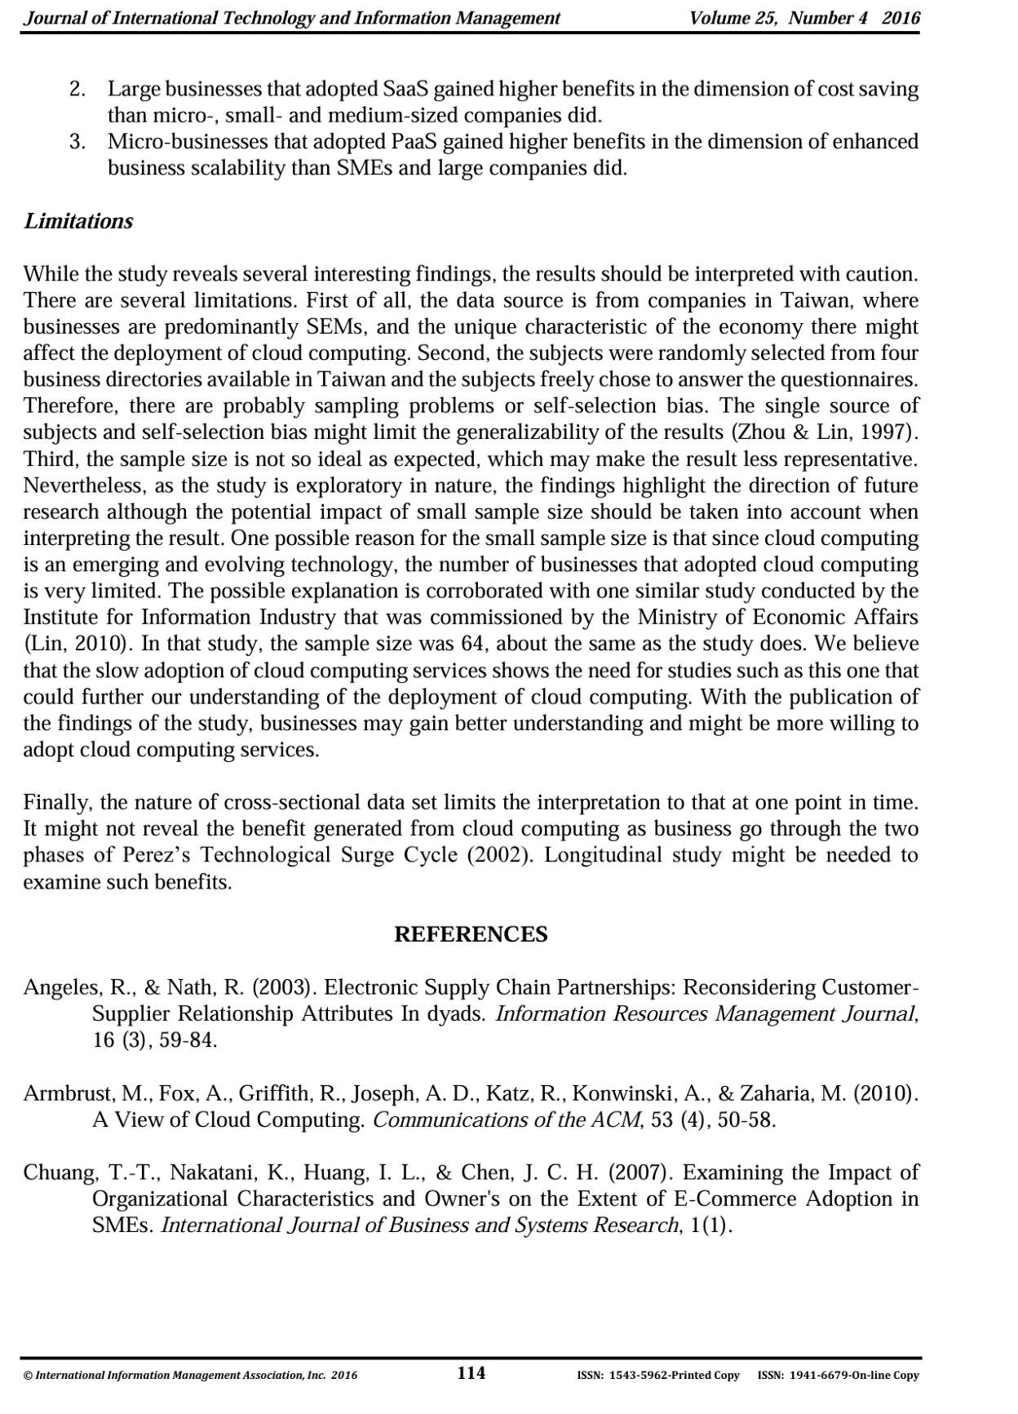

Slide 49
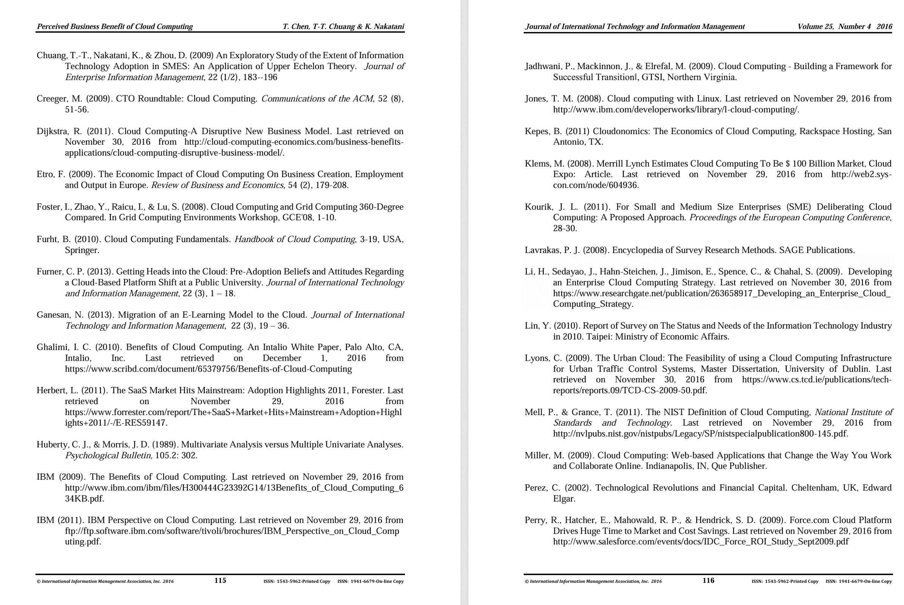

Slide 51
Academic writing & language
Academic writing is a formal approach
  Formal structure following academic conventions
  Formal tone and use of language
Writing in an academic style is something that can be learnt through guidance and conscientious practice
Notes:
You need to develop a formal 'academic voice' in your writing. This is one that follows and replicates established conventions in terms of structure (essay intro, middle, conclusion) formality and referencing. You must do this if you want to achieve a good grades in a higher education context.
The style of academic writing is unique and has distinct (though sometimes subtle) differences from all other genres and approaches (journalism, reflective writing, report writing, novels, creative writing). The best way to identify these differences is to look out them yourself as you read through other written formats.
The ability to write in an academic style is not something that we are born with, but it is something that can be learnt and developed by consistent and conscientious practice.

